Slide 1
C Programming Iterative execution of code using Loops Lecture-7
Dr. Asif Uddin Khan

Slide 2
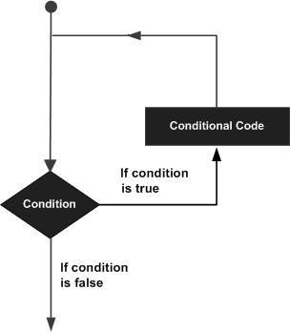
Iterative execution of code using Loops
A loop statement allows execution of a statement or group of statements multiple times.
C programming has three types of loops
while loop
do...while loop
for loop

Slide 3

while loop
while loop repeatedly executes a target statements as long as a given condition is true.
Syntax
statement(s) may be a single statement or a block of statements.
The condition may be any expression, and true is any nonzero value.
The loop iterates while the condition is true.
When the condition becomes false, the program control passes to the line immediately following the loop.

Slide 4
Example 1: while loop
// Print numbers from 1 to 5
#include <stdio.h>
int main() {
int i = 1;
while (i <= 5) {
printf("%d\n", i);
++i;
}
return 0;
}
Output
1
2
3
4
5

Slide 5
Example 2: while loop
int main () {
/* local variable definition */
int a = 10;
/* while loop execution */
while( a < 20 ) {
printf("value of a: %d\n", a);
a++;
}
return 0;
}
Output
value of a: 10
value of a: 11
value of a: 12
value of a: 13
value of a: 14
value of a: 15
value of a: 16
value of a: 17
value of a: 18
value of a: 19

Slide 6
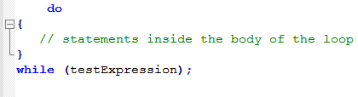
do...while loop
The do..while loop is similar to the while loop with one important difference.
The body of do...while loop is executed at least once. Only then, the test expression is evaluated.
Syntax

Slide 7
How do...while loop works?
The body of do...while loop is executed once. Only then, the test expression is evaluated.
If the test expression is true, the body of the loop is executed again and the test expression is evaluated.
This process goes on until the test expression becomes false.
If the test expression is false, the loop ends.

Slide 8
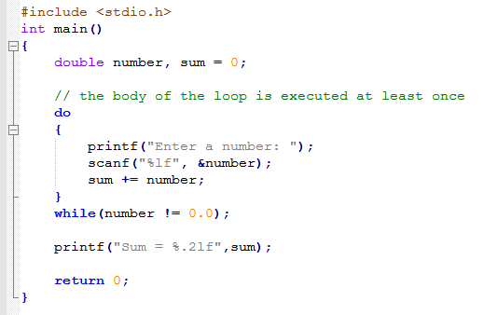
Program using do...while loop

Slide 9

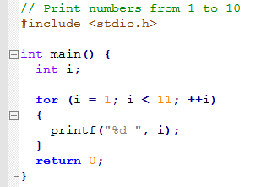
for Loop
Syntax
How for loop works?
The initialization statement is executed only once.
Then, the test expression is evaluated. If the test expression is evaluated to false, the for loop is terminated.
However, if the test expression is evaluated to true, statements inside the body of for loop are executed, and the update expression is updated.
Again the test expression is evaluated.

Slide 10
Logic for adding the digits of a number
int sum,x,m;
sum=0;
while (x > 0) {
m = x%10;
sum = sum+m;
x = x/10;
}

Slide 11
Logic to find the reverse of a number
Reverse=0;
while(n!=0)
{
rem=n%10;
reverse=reverse*10+rem;
n=n/10;
}

Slide 12
References
C programming by E Balaguruswami
Programming C by Y. kanitkar
Programming C by Denis Ritchie
NPTEL Lecture note of Dr. Partha Pratim Das, Department of Computer Science and Engineering, Indian Institute of Technology, Kharagpur.
https://docs.oracle.com/cd/E18752_01/html/817-6223/chp-typeopexpr-2.html
https://data-flair.training/blogs/escape-sequence-in-c/
Internet source

